Slide 1
Meeting of the Balkan Excellent Centers
“Adiponectin and hypertension: nothing is simple
Data from Croatian Rural Study”
Vanja Ivković
UHC Zagreb
Department of Nephrology, Hypertension, Dialysis and Transplantation
ESH Excellence Center
Notes:
Για την διαχρονικά σταθερή στηριξή του

Slide 2
Abstract
Adiponectin is an adipokine secreted almost exclusively from fat tissue and is associated with a positive metabolic profile (i.e. it is negatively associated with BMI, waist circumference, insulin resistance and LDL cholesterol) (1, 2, 3). The association of adiponectin and hypertension and its role in hypertension is still a matter of debate (4, 5). The majority of studies show a negative association, but in many there is a lack of association. Obtained conflicting results could be mostly explained with diversity of subjects included in different studies. We conducted a study in which we examined these associations and showed that in our rural population with normal kidney function there is no association of adiponectin with systolic or diastolic blood pressure as well as risk of hypertension (5). Additionally we performed a genetic association study on two of the quite important ADIPOQ gene polymorphisms, -11377C>G and -11391G>A, and did not find an association of these genotypes or haplotypes with hypertension in any of five genetic models (codominant, dominant, recessive, log-additive and overdominant). In our study we carried out for the first time a thorough population analysis and literature review which included papers with a total of >20,000 subjects. This data could prove valuable to future ADIPOQ gene polymorphisms. In conclusion, the differing and complex association of adiponectin and blood pressure is probably a consequence of different populations set on different points of the cardiometabolic continuum as well as differences in genetic constellations.

Slide 3
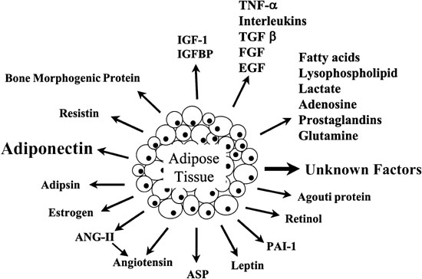
Known adipokines
most abundant!
Notes:
Adipose tissue – first thought of as an inactive connective tissue, now as an active energy storage and a major endocrine organ. Secretes adipokines (cytokines from fat tissue) – now more than 50 and the number is increasing.

Slide 4
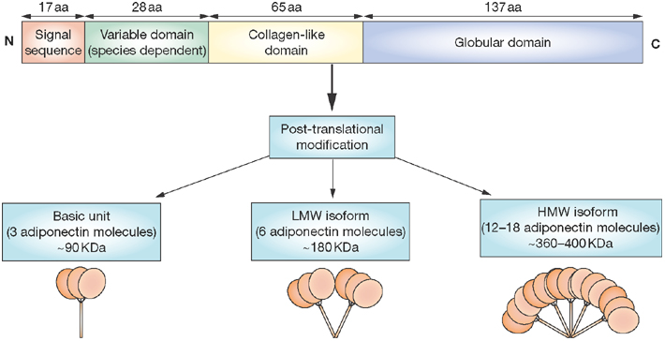
Adiponectin
Adipokine secreted exclusively from fat tissue
Also known as Acrp30/adipoQ/apM1/GBP28
Exists in three higher order forms
only?/most? active isomer
Notes:
Discovered in 1995 in mouse adipocites… interest grew in 1999 when negative association with obesity was found (contrary to majority of other adipokines, namely leptin).
Forms multimeres, at least three – trimere, LMW, HMW (added together they give TOTAL adiponectin)… HMW isomer is thougt to at least be the most active, if not the only actie isomer (studies show that HMW/total ratio is independent predictor for metabolic disorders).
Two types of receptors – R1 found everywhere but especially in muscle tissue, R2 found in liver.

Slide 5
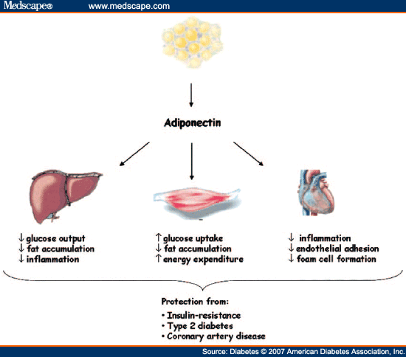
Effects of adiponectin
Effect on blood pressure…

Slide 6
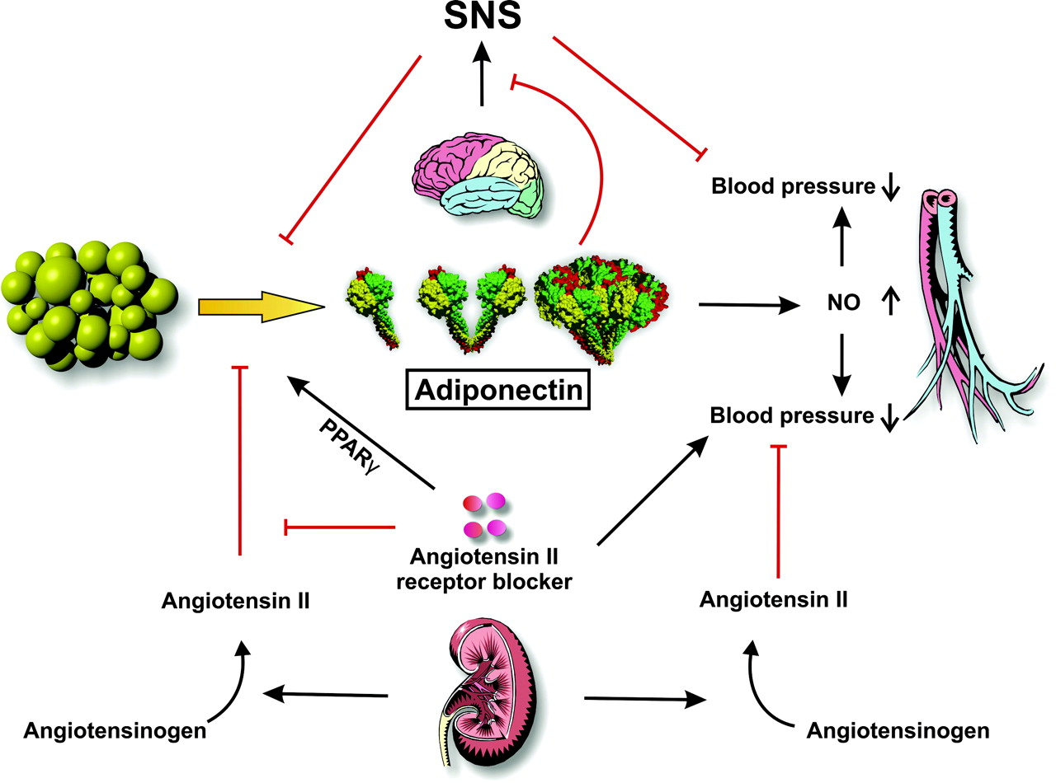

The role of adiponectin in hypertension
Lowering BP
Insulin senzitizing
Antidiabetes
Cardioprotection
Wang Z V , and Scherer P E Hypertension. 2008;51:8-14
Copyright © American Heart Association, Inc. All rights reserved.
Notes:
1. Adiponectin and NO
Adiponectin stimulates eNOS = rise in NO = vasodilation = lower BP (endothelial dysfunction)
2. Adiponectin and RAS
RAS in obesity = overproduction of ATII = hypertension, insulin resistance
ACEI = lower BP BUT ALSO: insulin senzitization, cardioprotection, antidiabetes.
Watanabe et al. ACEI = rise in Adiponectin, but not with calcium channel blockers (same effect on BP, though), also ARB.
Effect only seen through angiotensin R subtype 1, not 2.
Angiotensin II infusion in rats = rise in ROS (… and other mechanisms) = decrease in adipo = and LATER rise in BP!
3. Adipo and SNS
↑SNS → ↑ HR and TPR → HT
Imai et al. Cold stimulation model
rats on 4 C → inhibited transcription and secretion of adiponecin REVERSED with beta antagonists!
Main role of beta3 (fat tissue) but probably of beta1/2.
In vitro = beta3 agonists → ↓ adipo mRNA
Tanida et al
Adipo dose dependent → ↓ BP, sympatethic activity → Centrally! (adipo in CSF).

Slide 7
Adiponectin and hypertension – meta analysis
43 non prospective and 5 prospective studies
17 598 subjects (8220 hypertensives)
Normotensives
Adiponectine concentration
- 1.64 mg/L
Hypertensives
Notes:
Large meta analysis by Kim et al.
Data from non prospective studies show that hypertensives had on average 1.64 mg/L lower plasma adiponectin concentrations…

Slide 8
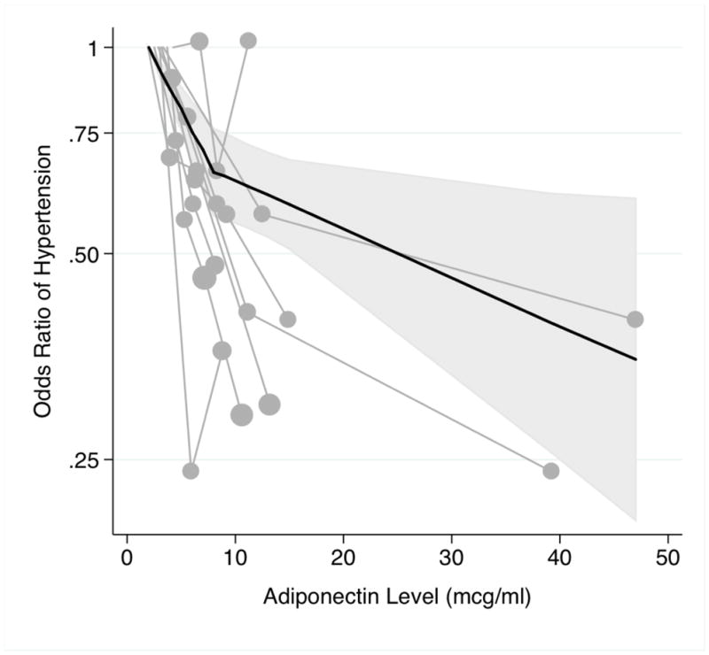
↓ 6 % per mg/L
Not significant

Slide 9
However…
Is there really an association of adiponectin and BP?......
Notes:
At least one quarter (two other studies showing no association in one sex)
No relationship between adipo and bp or no difference in nt and ht

Slide 10
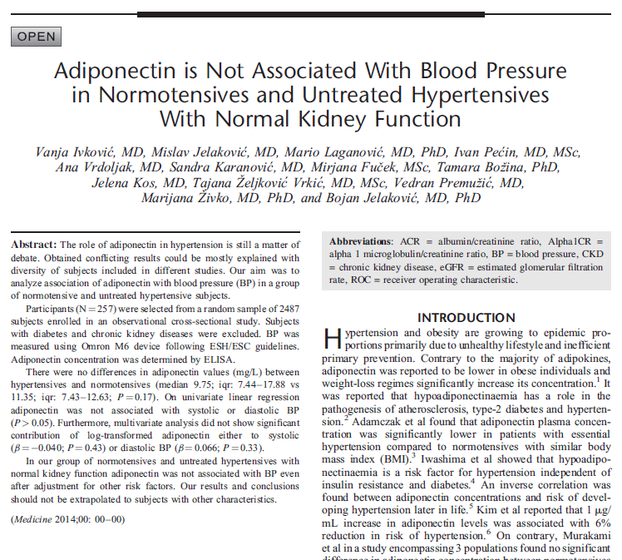
Notes:
To try and resolve the conclusion… normal kidney function, young (age)
Had more subjects than 25 out of 43 studies

Slide 11
Subject enrollment
Notes:
Only persons with normal eGFR included so as to excludde posibility of decreased KF affecting adipo and vice versa

Slide 12
Normotensives
Adiponectine concentration
P=0.17
Hypertensives
11.35 (7.44-17.88) vs. 9.75 (7.43-12.63)

Slide 13
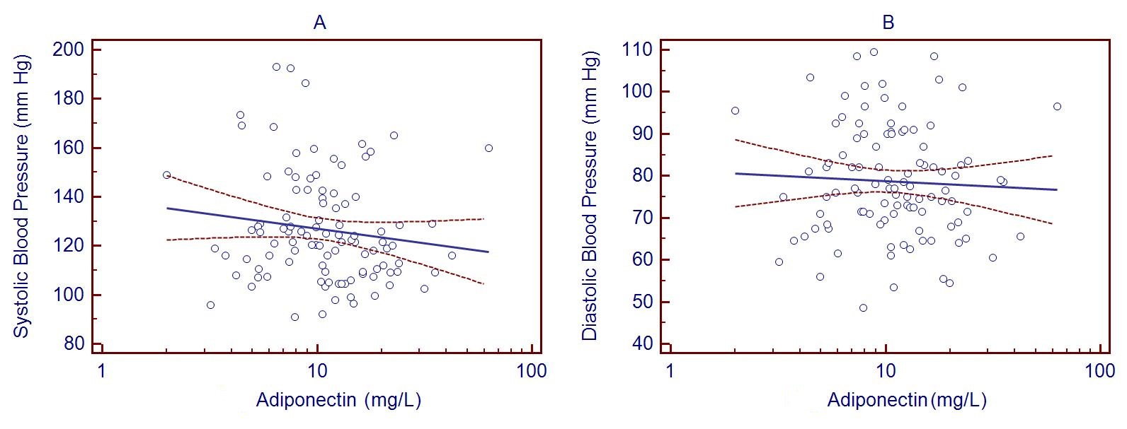
Association of adiponectin and BP
β= -0.040, p=0.43
β=0.066, p=0.43

Slide 14
So... what next?
some studies show negative association, some don’t, some show positive association
possible heterogeneity between populations?
influence of kidney disease/function?
possible heterogeneity between stages of cardiometabolic continuum?
Consequence of difference in single nucleotide polymorphisms (SNPs)???

Slide 15
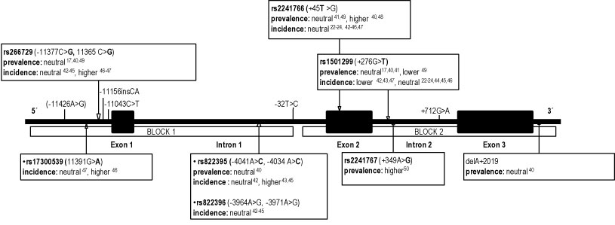
-11377 C>G
-11391 G>A
…two common, frequently researched SNPs…
… in the Asian population (association with HT 4 studies)…
…in Europeans 0 studies!!!

Slide 16

First step… determining general alelle prevalences
118 papers
MAF 26,18%
20 populations
MAF 10,11%
25 583 persons

Slide 17
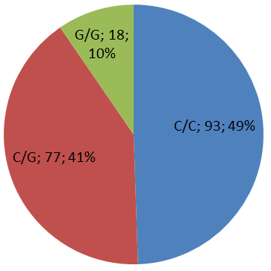
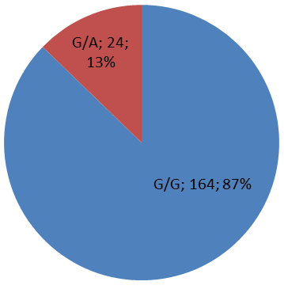
Genotype distribution
Congurent with standard EUR and CEU populations
-11377 C>G
-11391 G>A

Slide 18
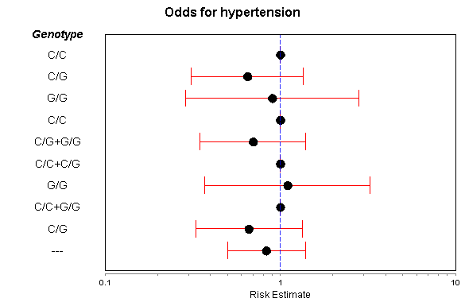
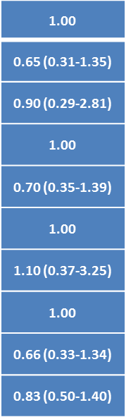
-11377 C>G
OR (95% CI)
Model
Codominant
Dominant
Recessive
Overdominant
Log-additive

Slide 19
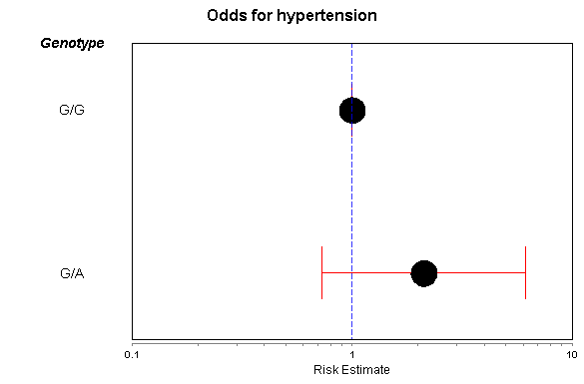
-11391 G>A
Model
1.00
Codominant
2.12 (0.73-6.16)

Slide 20
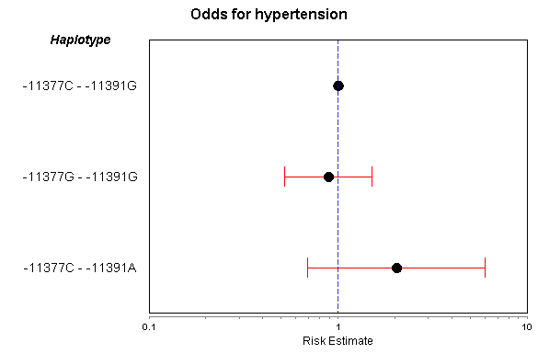
Haplotypes
1.00
0.89 (0.52-1.51)
2.04 (0.69-6.03)

Slide 21
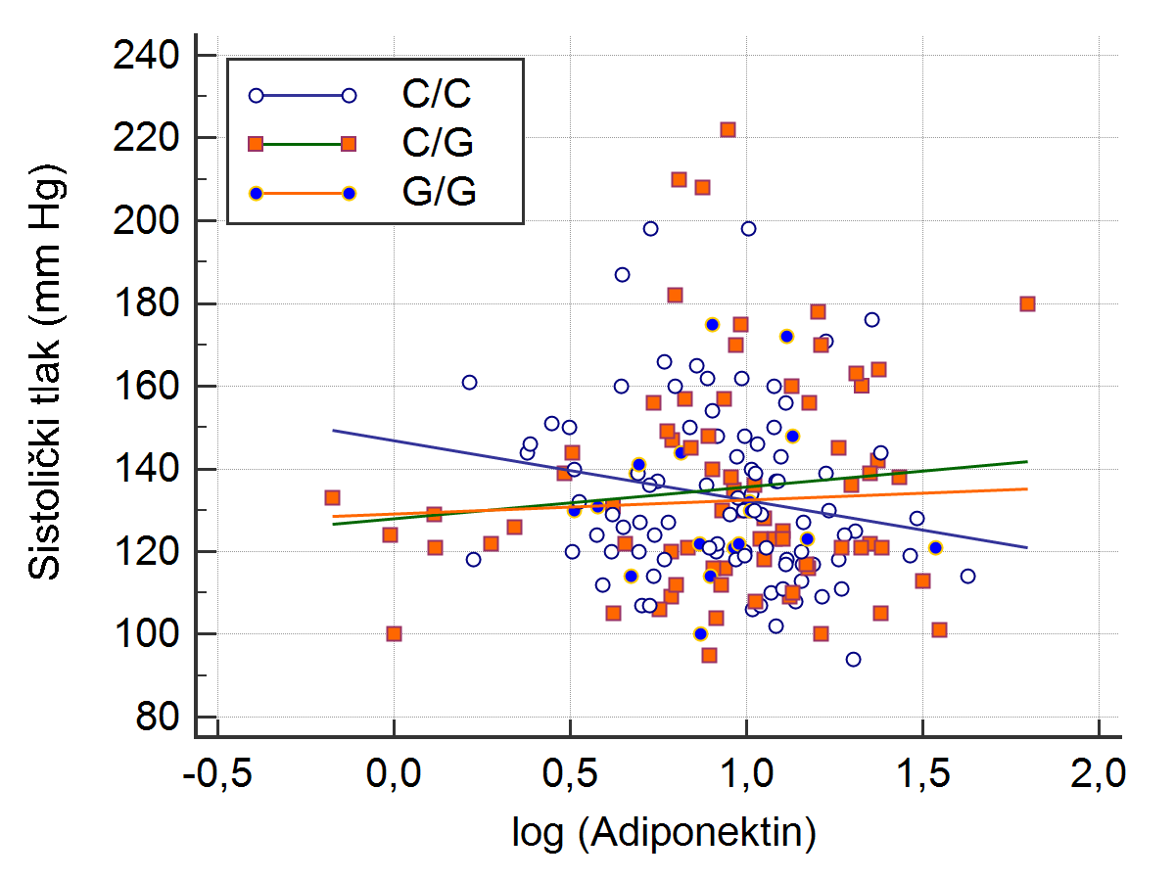
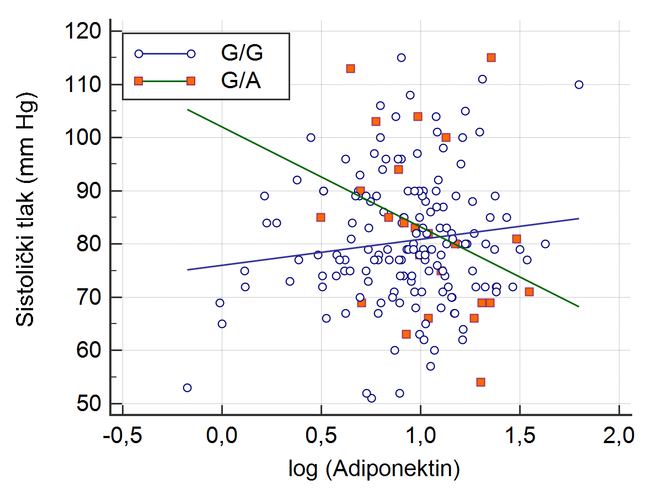
So… is there an association between SNPs and BP?
?

Slide 22
Conclusion
Adiponectin is not related to BP in our population → normal kidney function
No difference in adiponectin between NT and HT with normal kidney function
Adipo-BP relationship is not the same in different stages of hypertension and/or target organ damage and these results should not be extrapolated to other populations
Polymorphisms -11377 C>G and -11391 G>A are not associated with HT, but minor allele A is associated with lower insulin resistance
Different associations with BP in different genotypes?
Future studies – interactoms?
Notes:
Kidney impairment influence on adiponectin and vice versa is excluded
Heterogenous relationsip in different populations

Slide 23
What to remember
Adiponectin has important influence on obesity, insulin resistance, DM, BP, HT…
Relationship of adiponectin and BP is complex and probably differs in different populations
Adiponectin might be an important future marker of metabolic disorders

