Slide 1
Meeting of the Balkan Excellent Centers
“Hypertension prevalence in Romania:
preliminary results from SEPHAR III survey”
Prof. Dr. Maria Dorobantu
“Carol Davila” University of Medicine and Pharmacy,
Clinical Emergency Hospital Bucharest
President of Romanian Society of Hypetension
Notes:
Για την διαχρονικά σταθερή στηριξή του

Slide 2
Abstract
The two SEPHARs cross-sectional national surveys carried out in the last seven years, revealed that the tendency of HT’s prevalence among romaninan adult population seems to be a descending one, with an increase in awareness, treatment and control of this condition. Still HT in Romania at this time still remains an “unsolved equation”. A recent analysis of SEPHAR II data regarding factors influencing BP control in romanian hypertensive patients concluded that increasing the awearness and level of education in regard to HT of general population will positively impact the trend of BP controll. In this current situation, Romanian Society of Hypertensions has organised a series of actions targeting the increase in the awearness and the level of education in regard to HT and continuos medical educational programs both for physicians and for nurses offering medical care to hypertensive patients. However, in this moment, having only two national representative evaluations does not enable us to estimate a trend in HT prevalence, treatment, and control in Romania, that has a crucial importance for the development of prevention strategies at national level. Also, we need to know if RSH’s actions had the estimated impact on HT prevalence, treatment, and control.
Those were the main premises for designing and conduction of a new epidemiologic national survey SEPHAR III, on a representative sample of approximately 2000 adults selected by means of a multi-stratified proportional sampling procedure (criteria for sample selection were: territorial regions (Romania’s territory was divided in 7 regions plus the capital city Bucharest, based on the National Statistics Institute recommendations), locality type (cities with over 200 000 inhabitants, cities with 50 000-200 000 inhabitants, cities with less than 50 000 inhabitants, Commune), gender (male and female), age groups (18-24 years, 25-34 years, 35-44 years, 45-54 years, 55-64 years, 65-75 years, 75-80 years)

Slide 3
The 2 study visits (at 4 days interval) took part in a special "medical caravan" entitled SEPHAR BUS - fully equipped with all the medical equipment and proper facilities for the conduction for the study, that also allow the team to travel across the country in all the recruitment sites. The fieldwork team was made of cardiologists as primary investigators and senior residents in cardiology and nurses as sub -investigators, and a series of nurses designated by the central laboratory, responsible for blood and urine samples collection and their transport to the central laboratory. Compared to SEPHAR I and II surveys, SEPHAR III’s design brought the novelties of a complete target organ damage evaluation (by means of transthoracic echocardiography and Doppler ultrasound examination of the carotid arteries and measurement of ABI) , the inclusion of the MoCA, Epworth, Morinski and depression questionnaires in the case report form, and the estimation of 24h urinary sodium excretion from morning sport urine samples. SEPHAR III Preliminary results: between November 16th – November 23rd 2015 and February 15th – April 25th 2016, a total number of 2065 adult subjects (18 – 80 years) who gave written informed consent to participate in the study were enrolled. This intern analysis was performed on the data from 1776 enrolled subjects (86%). Hypertension was defined as study SBP ≥ 140mmHg and/or study DBP ≥ 90mmHg at both study visits, or previously diagnosed HT under treatment during the last two weeks, regardless of BP values, were study SBP/DBP was calculated as the arithmetic mean of the 2nd and 3rd BP measurement of each study visit. Hypertension control was defined as SBP < 140mmHg and DBP < 90mmHg in hypertensive subjects who were under treatment for at least 2 weeks before, taking into account the maximum value between the two SBP/DBP values from each visit. Preliminary results revealed a HT general prevalence of 47.5%, in the majority previously diagnosed HT – 39.9%, and a general awareness of HT of 84%. While treatment of HT was recorded in 80.3% of the hypertensive patients, BP cotroll of the treated hypertensive patients was 30.1%. Hypertension prevalence in Romania is increasing, although together with an increase in awareness, treatment and control. Possible explanations of this trend might be unhealthy life-style and diet, increased salt-intake and increase in obesity and diabetes mellitus. SEPHAR III date will offer an estimation of a real 11 – years trend in HT’s prevalence, treatment, and control (2005-2016) and will serve as base for future prevention strategies urgently needed in our country!

Slide 4
HT prevalence
Romania vs. Europe
Dorobantu M. et all. ” Arterial Hypertension Epidemiology: Romania among the Balkan Countries – Data from SEPHAR Surveys ”, Medicina Modernã. 2014, Vol. 21, No. 1 : 10-16

Slide 5
HT prevalence
Romania vs. Balkan Region
Dorobantu M. et all. ” Arterial Hypertension Epidemiology: Romania among the Balkan Countries – Data from SEPHAR Surveys ”, Medicina Modernã. 2014, Vol. 21, No. 1 : 10-16

Slide 6
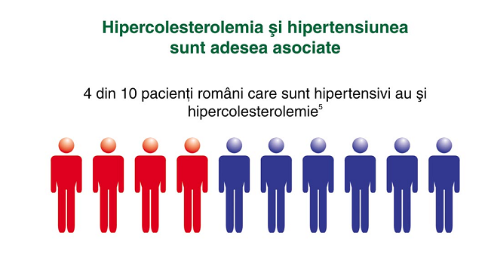
HT in Romania
Current situation
4 out of 10 Romanian adults have HT
1 out of 2 hypertensive adults are treated
1 out of 4 treated hypertensives are at target BP
(~900.000 out of 7M with HT)

Slide 7
The need of a new national survey: SEPHAR III
To find answers:
What is the trend in HT prevalence, treatment and control in Romania?
SEPHAR I
2005
SEPHAR III
2016?
SEPHAR II
2012

Slide 8
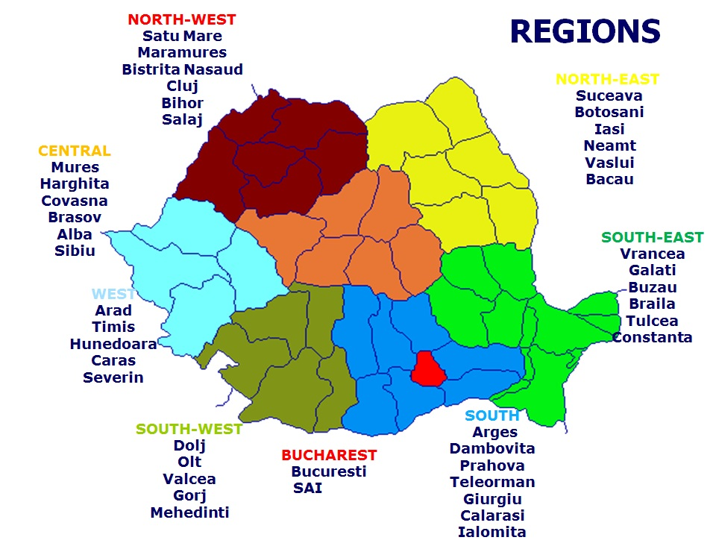
The need of a new national survey: SEPHAR III
To find answers:
What is the current prevalence, treatment and control of HT in Romania?

Slide 9
SEPHAR METHODOLOGY
Cross-sectional survey ➔ multistratified sampling procedure
2 study visits (4 days apart)
questionnaire interview
BP and anthropometric measurements according to current ESH guidelines
Laboratory work-up
    Fasting plasma glucose, HbA1c
    Lipid profile
    Serum creatinine
    Serum K,
    Serum uric acid
    UACR

Slide 10
SEPHAR III NOVELTIES
Complete target organ damage evaluation
Carotid IMT/plaques
ABI
12 lead ECG
Arterial stiffness (PWVao)
Echocardiography
Albuminuria (UACR ratio)

Slide 11
SEPHAR III NOVELTIES
Assessment of dietary Salt intake/24 H
Assessment of salt consumption of adult Romania population
Basis of a draft law on reducing the amount of food salt

Slide 12
SEPHAR III NOVELTIES
Estimating the prevalence of sleep apnea syndrome in the adult Romanian population (Epworth scale).
.
Assessment of depression state of Romanian adult population and its impact on the cardiovascular morbidity
.
Evaluation of cognitive disorders of Romanian adult population (MoCA )

Slide 13

The need of a new national survey: SEPHAR III
SEPHAR BUS
EARLY DETECTION SAVES LIFES
November 16th – November 23rd 2015
February 15th – April 25th 2016
2065 adult subjects (18 – 80 years) enrolled

Slide 14
Sephar iii – interim analysis
1776 out of 2065 subjects (86%)

Slide 15
HYPERTENSION DEFINITION
Study SBP ≥ 140mmHg and/or study DBP ≥ 90mmHg at both study visits
or
previously diagnosed HT under treatment during the last two weeks, regardless of BP values
According to 2013 ESH-ESC Guidelines
study SBP/DBP = arithmetic mean of the 2nd and 3rd BP measurement of each study visit

Slide 16
PREVALENCE OF HYPERTENSION
*
*p< 0,0001; chi square test

Slide 17
PREVALENCE OF HT BY REGIONS
*p< 0,0001; chi square test

Slide 18
AWEARNESS OF BP VALUES
*p< 0,0001; chi square test

Slide 19
HYPERTENSION CONTROL DEFINITION
SBP < 140mmHg and DBP < 90mmHg in hypertensive subjects who were under treatment for at least 2 weeks before, taking into account the maximum value between the two SBP/DBP values from each visit.

Slide 20
TREATMENT AND CONTROL
*p< 0,0001; binomial test

Slide 21
INSTEAD OF CONCLUSIONS
SEPHAR III
Hypertension prevalence is increasing, allthough together with an increase in awareness, treatment and control
Possible explanations:
    Unhealthy life-style / diet ?
    Increased salt-intake ?
    Increase in obesity / DM ?
CV risk stratification

Slide 22
INSTEAD OF CONCLUSIONS
SEPHAR III
estimation of a real trend in HT’s prevalence, treatment, and control (2005-2016)
base for future prevention strategies urgently needed in our country!

Slide 23
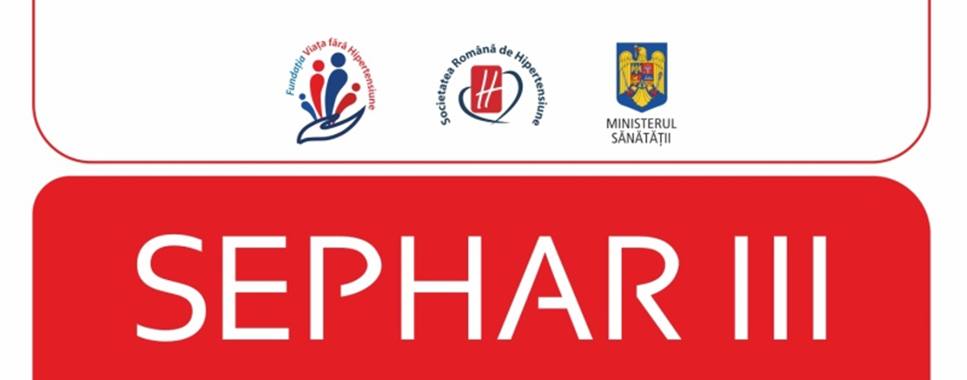
National Study Coordinator: Prof. Dr. Maria Dorobantu
Study Steering Committee:
Prof Dr. Doina Dimulescu
Prof. Dr. Crina Sinescu
Prof. Dr. Daniel Lighezan
Prof. Dr. Catalina Arsenescu- Georgescu
Prof. Dr. Ovidiu Mitu
Prof. Dr. Dana Pop
Conf. Dr. Cornelia Bala
Conf. Dr Calin Pop
Conf. Dr. Roxana Darabont
Dr. Paul Gusbeth- Tatomir
Dr. Oana Tautu
Dr. Alina Giuca
Dr. Mihaela Udrescu
Dr. Valeria Herdea
Dr. Ileana Branza
Asist Elena Paun

Slide 24


Slide 25
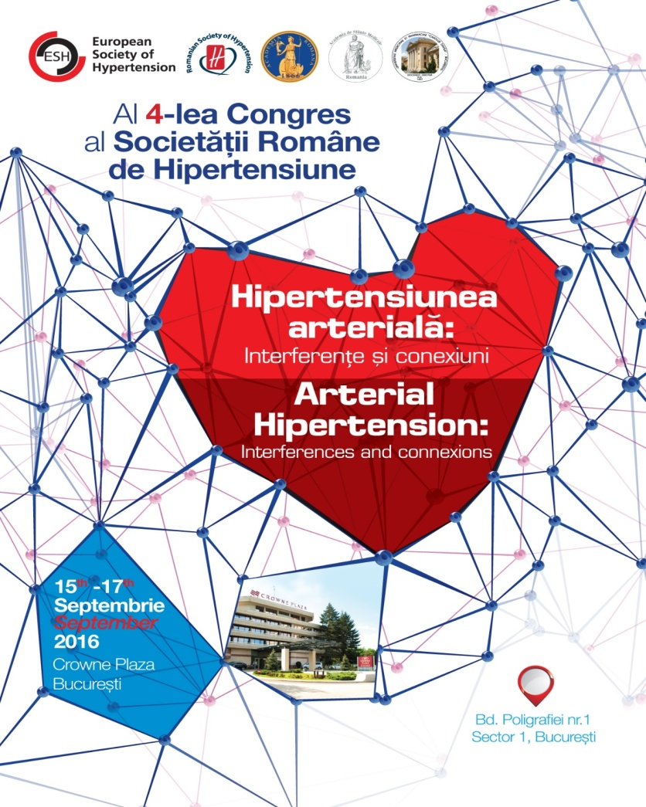
SEPHAR III SESSION
FRIDAY , SEPTEMBER 16TH - MAGNOLIA HALL
SESSION NUMBER 11:
CHAIRPERSONS:
Giuseppe Mancia (Italy), Tomasz Zdrojewski (Poland), Gianfranco Parati (Italy)
National Study Coordinator – Maria Dorobantu (Romania)
  9:00 – 9:10 SEPHAR III design. HTN trend in Romania – Maria Dorobantu (Romania)
  9:10 – 9:20 Hypertension control - Catalina Arsenescu Georgescu (Romania)
  9:20 – 9:30 Awarness of hypertension and compliance level – Crina Sinescu (Romania)
  9:30 – 9:40 Hypertension and cardiac damage - Doina Dimulescu (Romania)
  9:40 – 9:50 Arterial stiffness - Roxana Darabont (Romania)
  9:50 - 10: 00 Hemodynamic profile of romanian hypertensive patient - Oana Tautu (Romania)
  10:00 – 10:10 Metabolic disorders - Cornelia Bala (Romania)
  10:10 – 10:20 Salt consumption of Romanian adult population - Paul Gusbeth Tatomir (Romania)
  10:20 – 10:30 Discussions

Slide 26
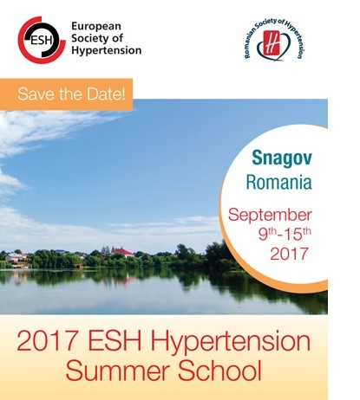

Slide 27
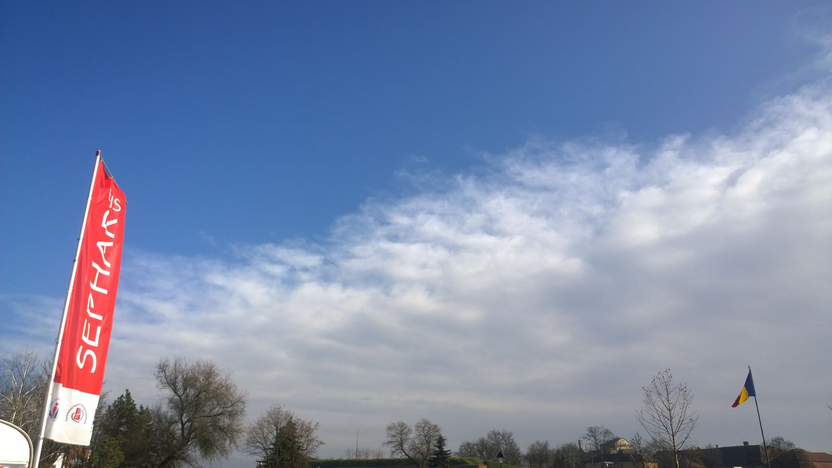
THANK-YOU!

