Slide 1
Orthostatic Hypertension: Impact on Cardiovascular Risk
From ESH 2016 | POS 1A:
Jean-Jacques Mourad, MD CHU Avicenne, Bobigny, France

Slide 2
Overview
Orthostatic hypertension (OH) is poorly understood
An association between mortality and OH has been demonstrated by evolving research
A review of the current understanding shows further research is required to determine whether OH is a risk factor or a risk marker of CV disease, and whether OH plays an independent role in specific populations
An agreed definition of OH and its optimal treatment needed

Slide 3
Overview
OH first described in 1985
[Streeten DH et al. Hypertension 1985]
Current definition: increase in systolic blood pressure (SBP) ≥20 mmHg when assuming an upright position (head-up tilting to 70 degrees within the study) from the supine position or a ≥20 mmHg increase in SBP after standing
[Kario K et al. J Am Coll Cardiol 2002]
Mechanisms of OH unclear, may differ by age, systolic or diastolic hypertension, normotensive or treated or untreated hypertensive

Slide 4
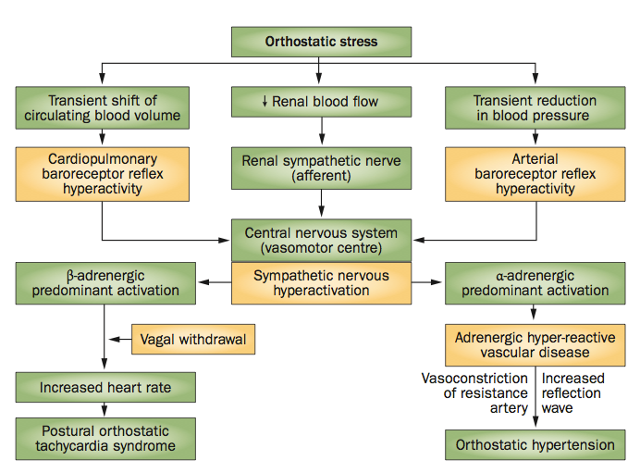
Possible Mechanisms of OH
Excessive venous pooling
Overshooting of sympathetic activation
Inadequate responses at the vascular level
Published in Kario K. Nat. Rev. Nephrol. 2013;9:726

Slide 5
Overview
OH is not a benign condition
Silent cerebrovascular disease and standing OH linked in elderly patients with hypertension [Kario K et al. J Am Coll Cardiol 2002]
Association between orthostatic increases and decreases in SBP and brain lesions in Atherosclerosis Risk in Communities study [Yatsuya Y et al. Hypertension 2011]
Decline in cognitive function in association with OH was found in a study of 334 community-dwelling adults aged ≥75 years (mean age 80 years) [Matsubayashi K et al. Stroke 1997]

Slide 6
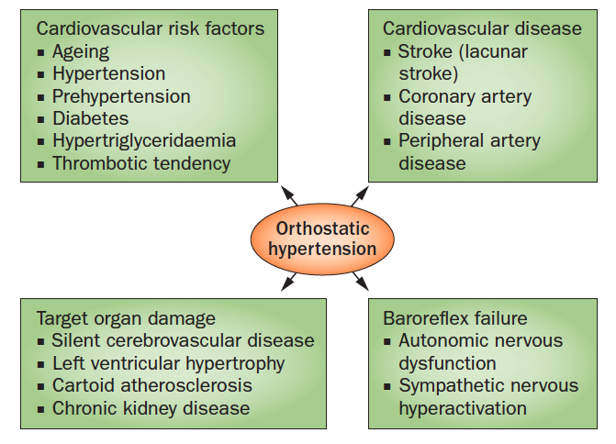
OH and Possible Related Conditions
Published in Kario K. Nat. Rev. Nephrol. 2013;9:726

Slide 7
Overview
OH is component of blood pressure variability patterns linked to CV morbidity and mortality
Association between OH and hard CV events shown in observational Pro.V.A. study and the PARTAGE (Predictive Values of Blood Pressure and Arterial Stiffness in Institutionalized Very Aged Population), with increase in all-cause mortality, CV mortality
Further research needed to determine if OH is a therapeutic target
Benefit with alpha-blockade shown in two studies

Slide 8
Orthostatic Hypertension: Impact on Cardiovascular Risk
From ESH 2016 | POS 1A:
Jean-Jacques Mourad, MD CHU Avicenne, Bobigny, France

